Slide 1
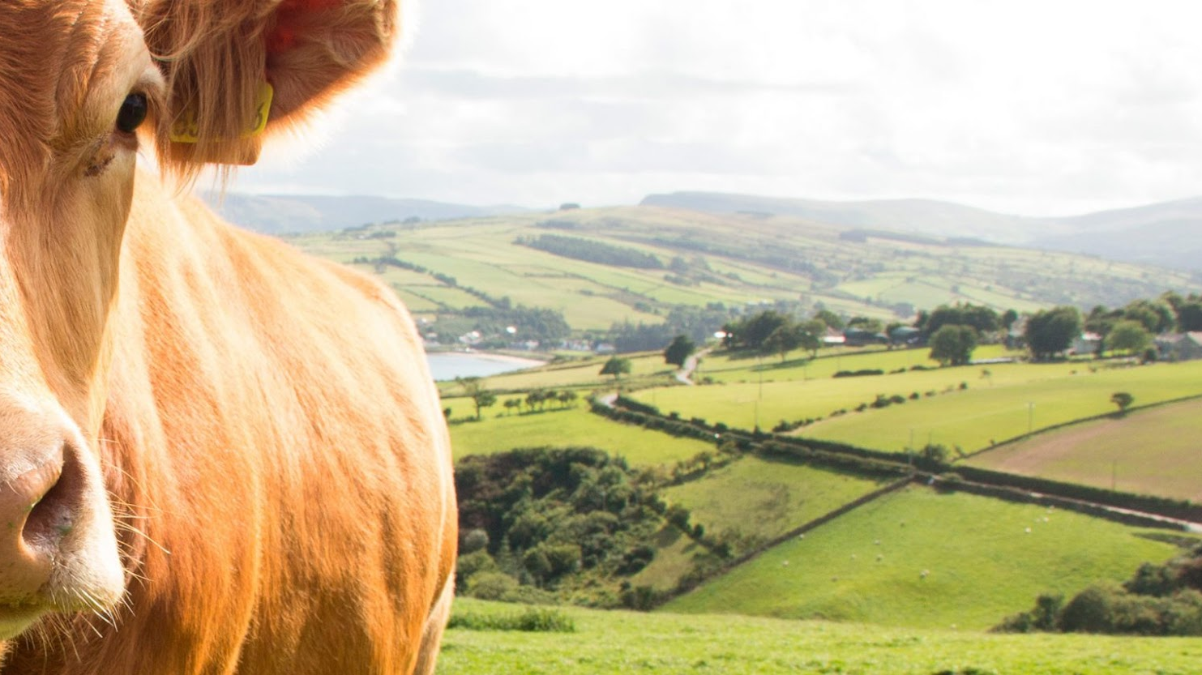

Automatization of livestock health checks with the use of algorithms

Slide 2






Team Presentation
Julian
Romero
Juan
Avendaño
Simón Marín
Mauricio
Toro
https://github.com/jeavendanc/ST0245-001

Slide 3
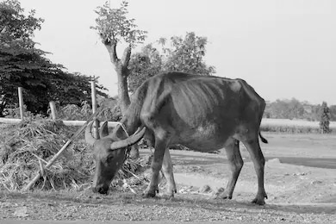
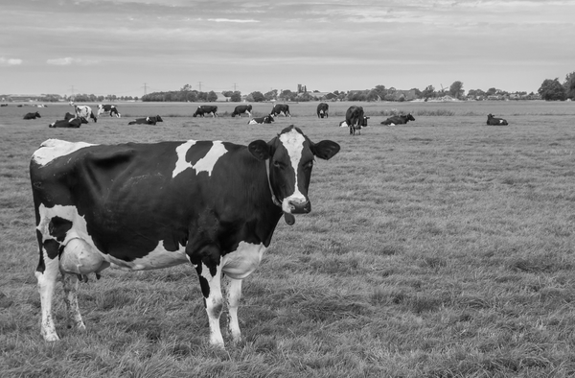
Training Process
Convolutional Neural Network
Sick-Cattle Images
Classification Algorithm
Classification Model
Healthy-Cattle Images

Slide 4

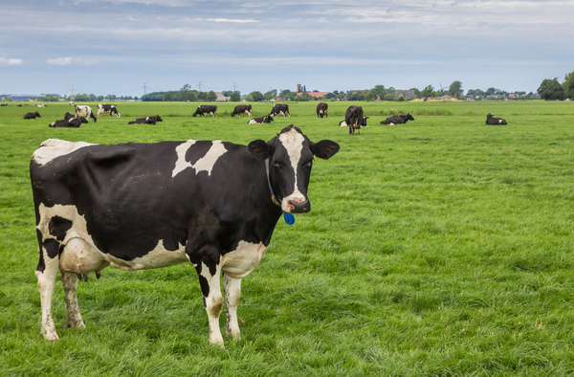
Testing Process
Is sick
Cattle Image
DXT1 Compression Algorithm
Classification Model
Output

Slide 5
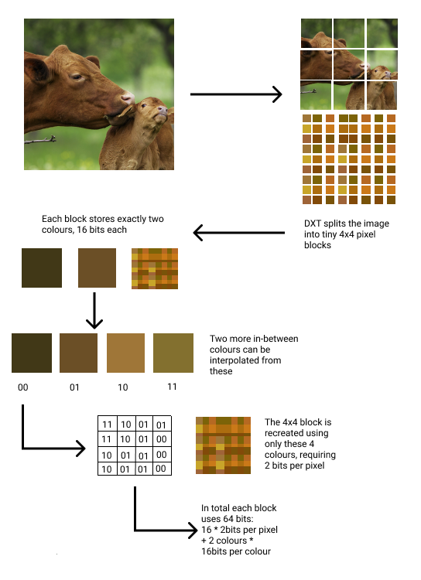
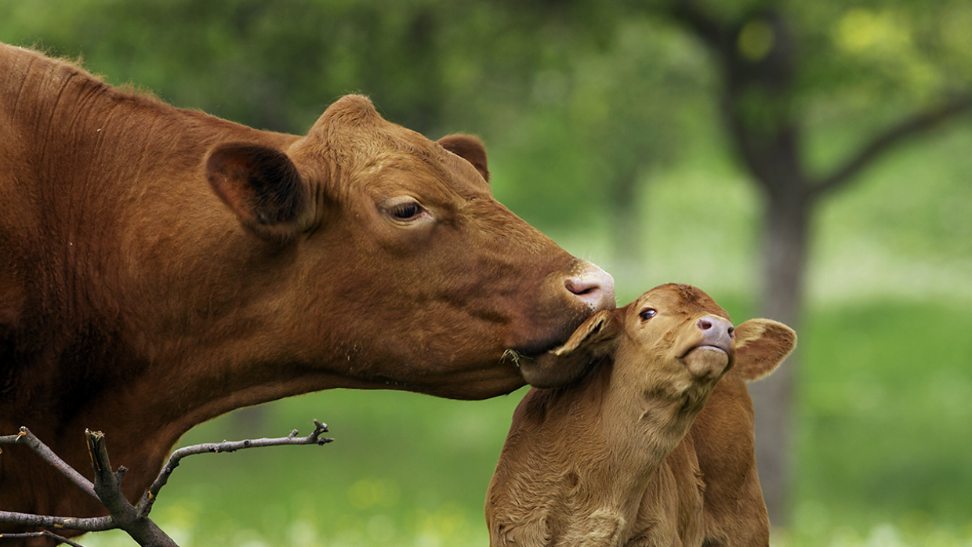
Compression Algorithm Design

Slide 6
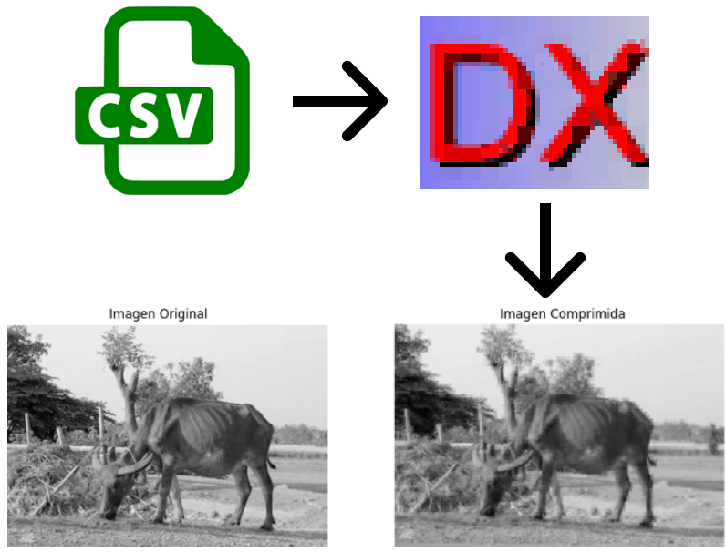
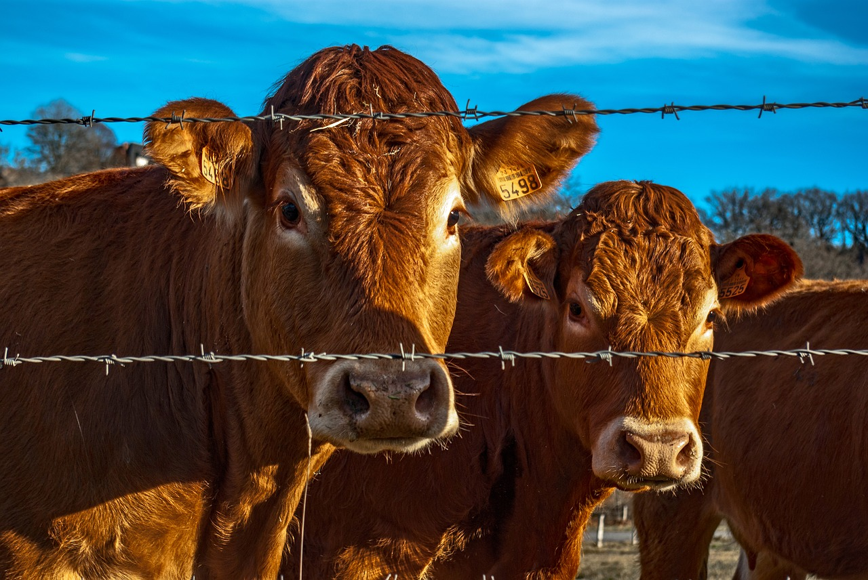
Compression Algorithm Design
The algorithm takes images in csv format, compress it with DXT1 method and then shows the final result, principally using data structures such as arrays and matrices.

